Slide 1
Convolutional neural network

Slide 2
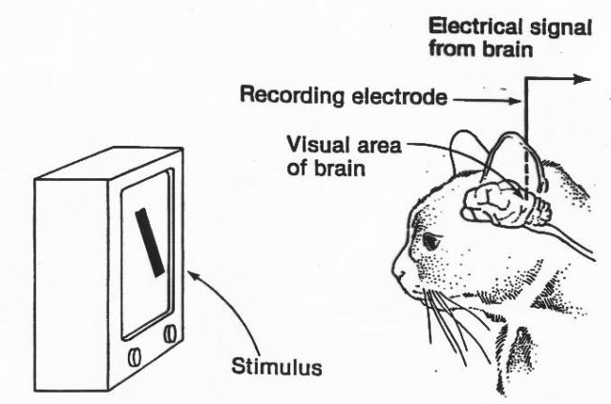
Hubel and Wiesel cat experiment
https://goodpsychology.files.wordpress.com/2013/03/hubel-experiment.jpg
https://youtu.be/IOHayh06LJ4
https://www.youtube.com/watch?v=Gv6Edl-pidA

Slide 3
LeNet
http://www.pyimagesearch.com/2016/08/01/lenet-convolutional-neural-network-in-python/

Slide 4
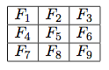
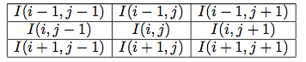
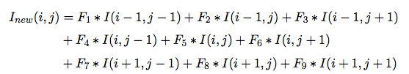
Convolution

Slide 5
Convolution
Padding ‘SAME’ will add 0 to edge, so that the image size can be maintained.
Stride is specified as a Tensor with 4 values [batchsize, width, height, channels]. So stride = [1, 2, 2, 1] implies that we will jump 2 pixels after convolution. This will reduce the image by half. It is preferable to use [1, 1, 1, 1] and padding=‘same’, so that image size is not modified by convolution.
Kernel specified as a Tensor with 4 values [batchsize, width, height, channels]. So stride = [1, 5, 5, 1] means that the filter will be applied to the width and height of the image.

Slide 6
Maxpooling
https://en.wikipedia.org/wiki/Convolutional_neural_network#/media/File:Max_pooling.png

Slide 7
MAXPooling
Padding ‘SAME’ will add 0 to edge, so that the image size can be maintained.
Stride is specified as a Tensor with 4 values [batchsize, width, height, channels]. So stride = [1, 2, 2, 1] implies that we will jump 2 pixels after convolution. This reduces the image size by 2.

Slide 8
LeNet
10 outputs
28 x 28 image
Conv1
Conv2
Max pooling
Max pooling
RELU with dropout

Slide 9
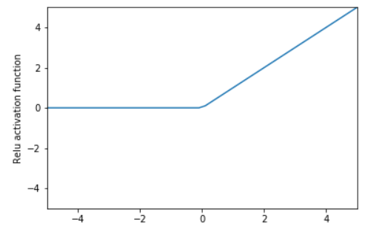
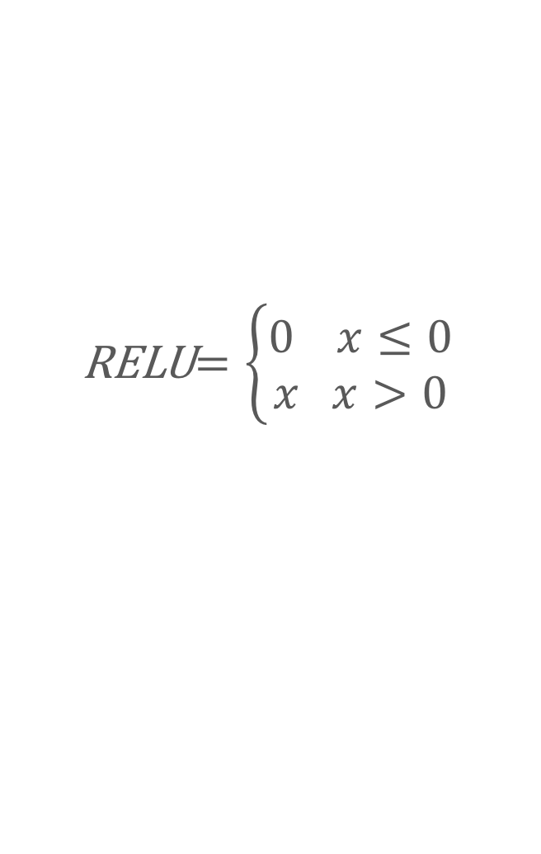
Relu activation
RELU$=\left\{\begin{aligned}0 x≤0 \\ x x>0\end{aligned}\right.$

Slide 10
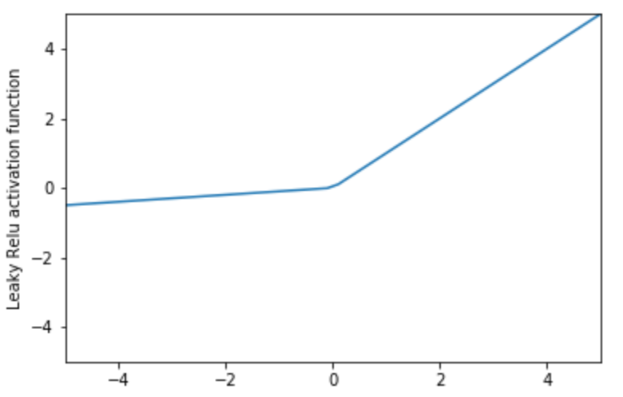
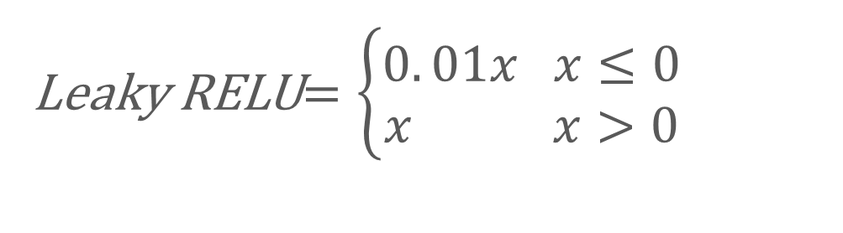
Leaky relu activation
Leaky RELU$=\left\{\begin{aligned}0. 01x x≤0 \\ x x>0\end{aligned}\right.$

Slide 11
overfitting
Poor fitting
y
Overfitting
x

Slide 12
Dropout to avoid overfitting
Dropout for training and not testing or predicting.
Drop a set of edges during training to avoid overfitting.
Works like ensemble method.
Similar in idea to resilience in a computer network.

Slide 13
https://medium.com/@amarbudhiraja/https-medium-com-amarbudhiraja-learning-less-to-learn-better-dropout-in-deep-machine-learning-74334da4bfc5

Slide 14
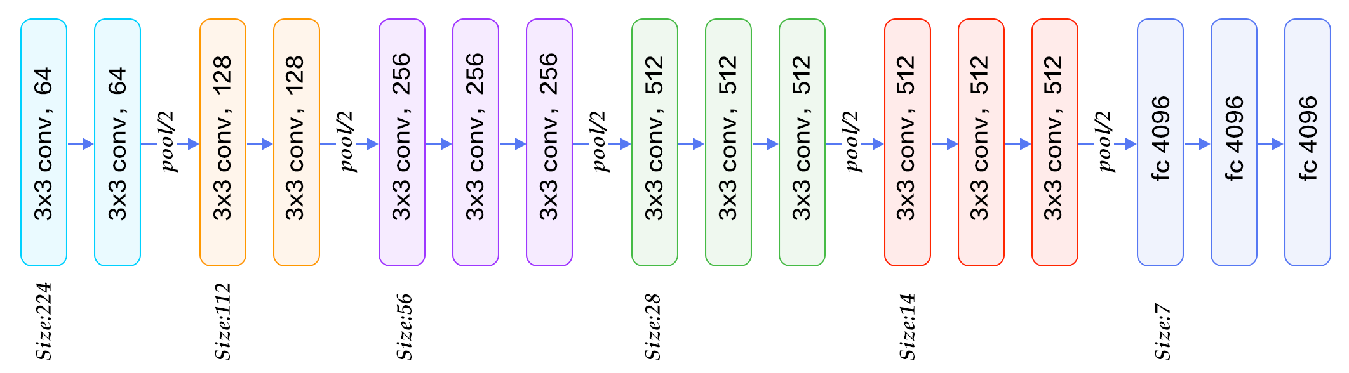
VGG16
https://www.quora.com/What-is-the-VGG-neural-network

Slide 15
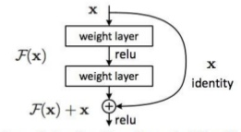
RESNET
https://www.slideshare.net/SomnathBanerjee17/lenet-to-resnet

Slide 16
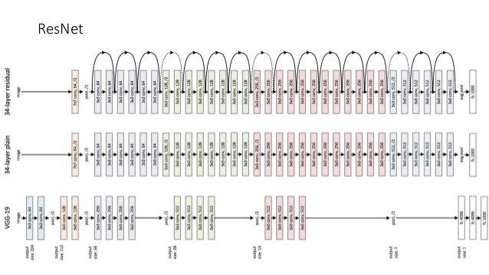
RESNET
https://www.slideshare.net/SomnathBanerjee17/lenet-to-resnet

Slide 17
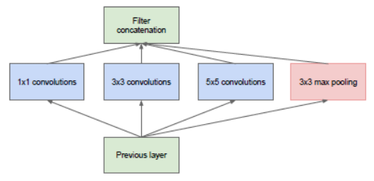
inception
https://www.quora.com/How-does-the-Inception-module-work-in-GoogLeNet-deep-architecture

Slide 18
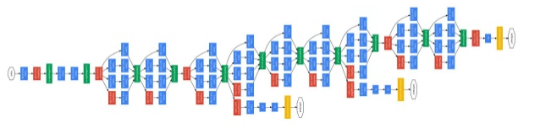
inception
https://www.slideshare.net/SomnathBanerjee17/lenet-to-resnet

Slide 19
reference
Ian Goodfellow et.al., “Deep learning”, Chapter 9
https://github.com/merantix/picasso Python module for visualizing CNN
http://cs231n.github.io/convolutional-networks/
https://www.youtube.com/watch?v=s716QXfApa0
https://www.youtube.com/watch?v=FmpDIaiMIeA
https://sites.google.com/site/nttrungmtwiki/home/it/data-science---python/tensorflow/tensorflow-and-deep-learning-part-3

